Slide 1
Data Structures & Algorithms (CSC-214)
Lec 2: ADTs

Slide 2
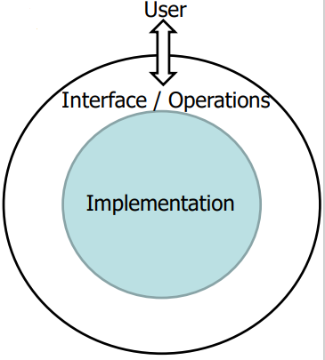
ADTs - Abstract Data Types
A definition of data type solely in terms of
Set of related data items (or values)
Set of operations on the data
Separation of logical properties from the implementation details
Hide implementation details (Encapsulation!)
The “abstract” part means that the data type is described independent of any implementation details.
What, not how, is the focus

Slide 3
ADTs - Examples
Whole numbers (integers)
Operations
Arithmetic operations (addition, subtraction, etc.)
Flight reservation
List of seats
Operations
Find empty seat
Reserve a seat
Cancel a seat assignment
Remember:
User interface is defined
Implementation independent
Operations are well defined

Slide 4
ADTs
A data structure is a physical implementation of an ADT
Each operation associated with ADT is implemented by one or more subroutines in the implementation
Provided in a language (primitive or built-in)
Built from the language constructs (user-defined)

Slide 5
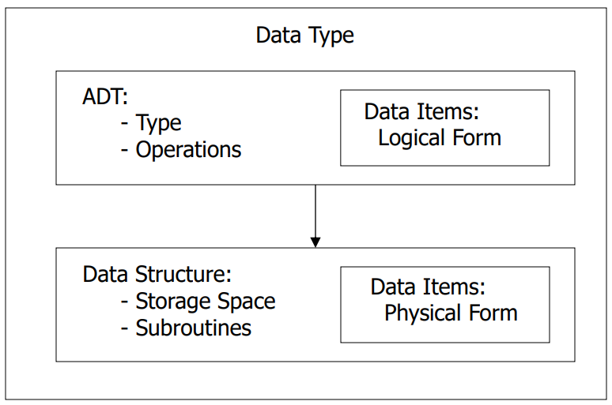
ADTs vs Data Structures

Slide 6
Example: Airplane Flight Reservation (1)
Consider example of an airplane flight with 10 seats to be assigned
Operations?
Implementation: How to store, access data?

Slide 7
Example: Airplane Flight Reservation (1)
Consider example of an airplane flight with 10 seats to be assigned
Operations
List available seats
Reserve a seat
Implementation: How to store, access data?
10 individual variables

Slide 8
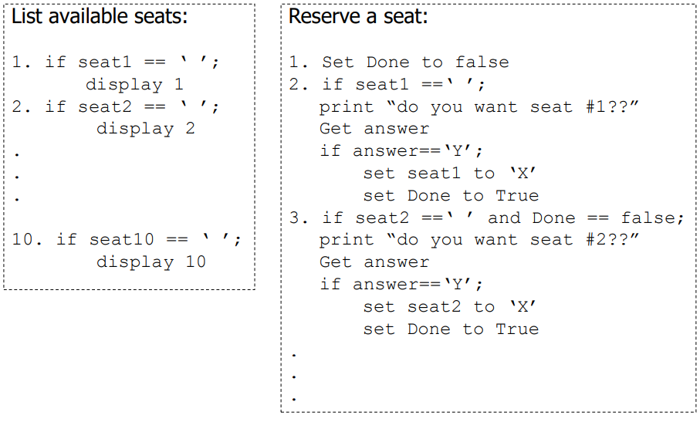
Implementation: 10 Individual Variables

Slide 9
Example: Airplane Flight Reservation (2)
Consider example of an airplane flight with 10 seats to be assigned
Operations
List available seats
Reserve a seat
Implementation: How to store, access data?
10 individual variables
An array of variables

Slide 10
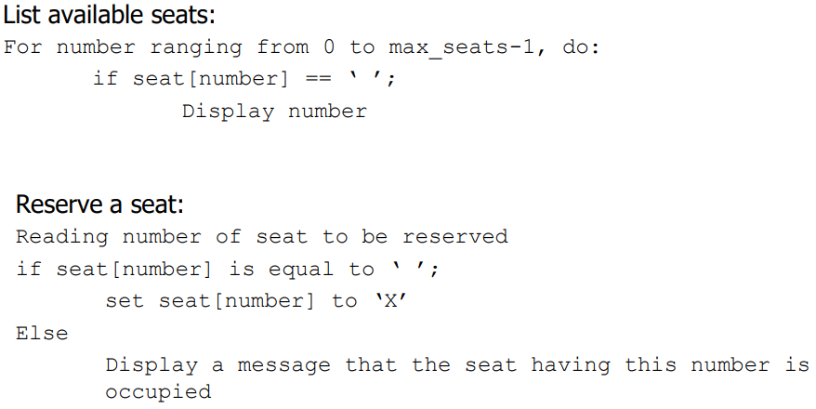
Implementation: An array of variables

Slide 11
Example: Airplane Flight Reservation (2)
This simple example illustrate the concept of an Abstract Data Type
ADT consists of
Collection of data items
Basic operations that must be performed on them
In the example:
Collection of data: list of seats
Basic operations: list available seats and reserve a seat

Slide 12
ADTs for Primitive Data Types
These primitive/predefined data types provide a foundation on which you construct more sophisticated data types, types that are collections of related data items, rather than individual data items

Slide 13
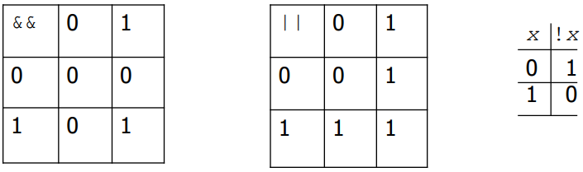
ADTs for Primitive Data Types
Boolean Data
Data values: {false, true}
Operations:
And &&
Or ||
Not !

Slide 14
ADTs for Primitive Data Types
Character Data
Data values
Numeric codes (ASCII, Unicode)
1 byte for ASCII, 2 bytes for Unicode (UTF-16)
Basic Operations
Comparison (equal, less than, greater)
Use of numeric codes
Ref: https://www.joelonsoftware.com/2003/10/08/the-absoluteminimum-every-software-developer-absolutely-positively-must-knowabout-unicode-and-character-sets-no-excuses/

Slide 15
ADTs for Primitive Data Types
Integer
Data values
Non-negative (unsinged) integer
Base-two representation in a fixed number of bits (e.g., 32 bits )
88 : 0000 0000 0000 0000 0000 0000 0101 1000
Signed integer
Ones’ or Two’s complement representation in fixed number of bits
127 : 01111111, -127: 10000000 (Ones’ complement)
127: 01111111, -127: 10000001 (Two’s complement)
Operations – Arithmetic operations
Addition, subtraction, multiplication, division

Slide 16
ADTs – food for thought
Why use ADTs?

Slide 17
ADTs – food for thought
Why use ADTs?
Programmers can separate concerns (interface vs. implementation)
Reused in different programs with different implementations
Performance can be optimized

Slide 18
ADTs – Practice Questions
Determine the data and operations if we want to represent the following as ADTs:
A Line at a Ticket Counter
Hospital Emergency Room
Undo/Redo in a Text Editor
Handling Customer Complaints in a Support Center

